Slide 1


Agenda
Content

Slide 2

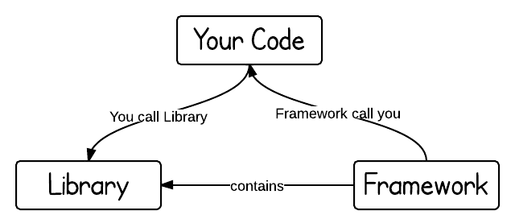
Introduction to UI5
SAPUI5 (SAP user interface for HTML5) or Open UI5 is a collection of libraries that you can use to build desktop and mobile applications that run in a browser. With the SAPUI5 JavaScript toolkit, you can create web applications using HTML5 web development standards.
SAP UI5 is a framework which is used to develop Responsive web applications to run on any platform, any browser and any OS.
Framework: - A framework, or software framework, is a platform for developing software applications. It provides a foundation on which software developers can build programs for a specific platform.
A framework may include predefined classes and functions that can be used to process input, manage hardware devices, and interact with system software.
Library: - A collection of Classes.
Classes: - Collection of methods, Attributes, Events.

Slide 3

Responsive Web Design
Responsive web design (RWD) is a web development approach that creates dynamic changes to the appearance of a web application, depending on the screen size and orientation of the device being used to view it.
Responsive Web Design is about using HTML and CSS to automatically resize, hide, shrink, or enlarge, a website, to make it look good on all devices (desktops, tablets, and phones).
Now a days, all the frameworks are designed to adept the UI according to the screen size of the device.

Slide 4
Structure of UI5 Framework
The UI5 framework is built on top of open standards like HTML5, CSS, JS, and jQuery. We use MVC architecture to create applications using SAPUI5.
BAS or
VSCode
App
SAP UI5 Design Time Component
SAPUI5 Runtime Component
HTML+CSS+JS
sap.m
sap.ui.comp
sap.ui.table
sap.ui.layout
Renderer
sap.ui.core
sap.ui.unified
sap.ui.core.mvc
HTML5
CSS
JS
jQuery

Slide 5
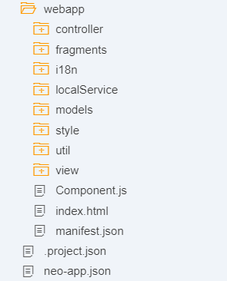
Project Structure of UI5 Project
When you create a new SAPUI5 application, you will be able to see a folder structure created in your project explorer like below.
In a SAP project there are a number of folders and files that you will not recognize if you are not familiar with MVC. Let's have a quick overview.
Within a given project, you have three core folders.
Model
View
Controller

Slide 6
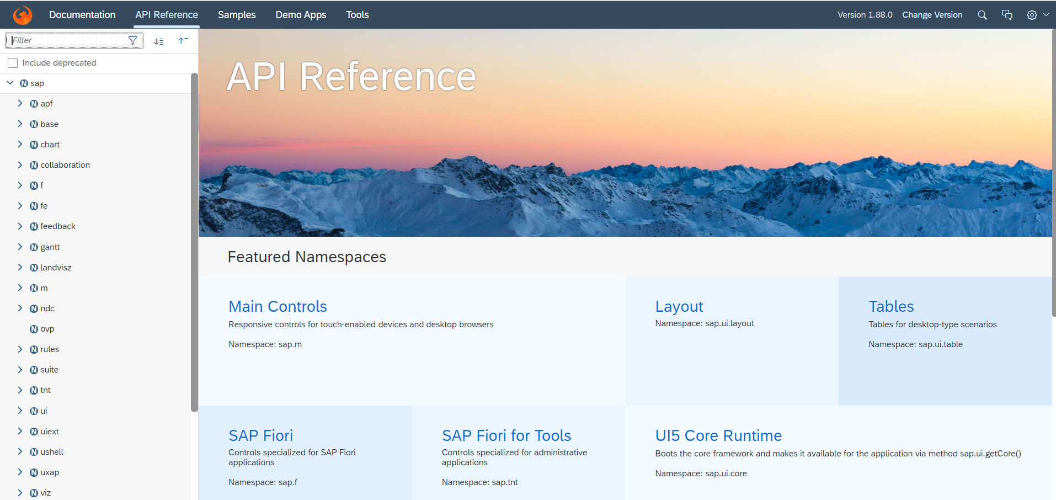
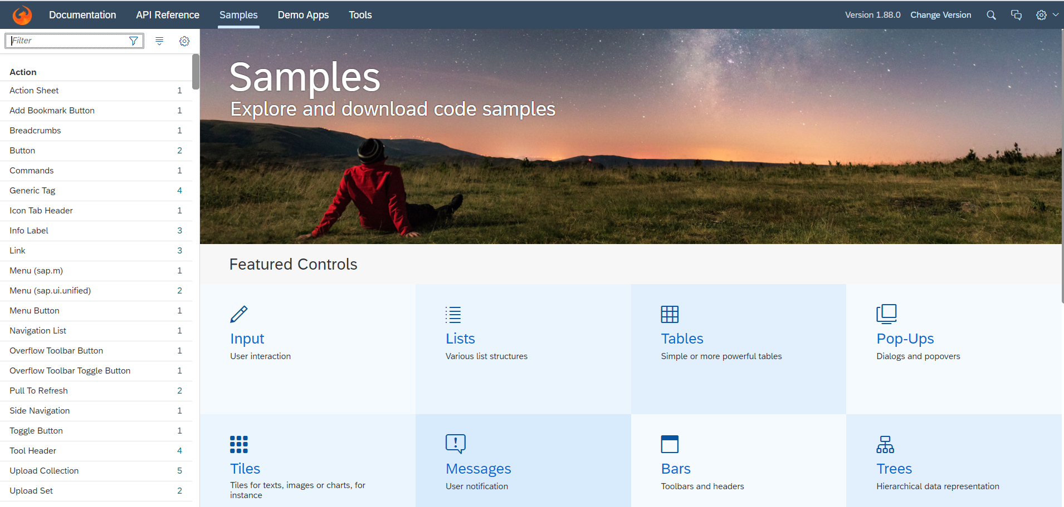
Introduction to UI5 SDK
Documentation of SAP UI5 is available at the SAPUI5 Software Development Kit.
We can access the SAP UI5 API’s at the Documentation page of SAP UI5 or you can use the link to go to sap’s API screen - https://sapui5.hana.ondemand.com/#/api
We can directly search the required api’s on the SDK.
SDK contains the sample of all the controls which we can use in UI5
SAP UI5 API reference screen
SAP UI5 Sample reference screen

Slide 7
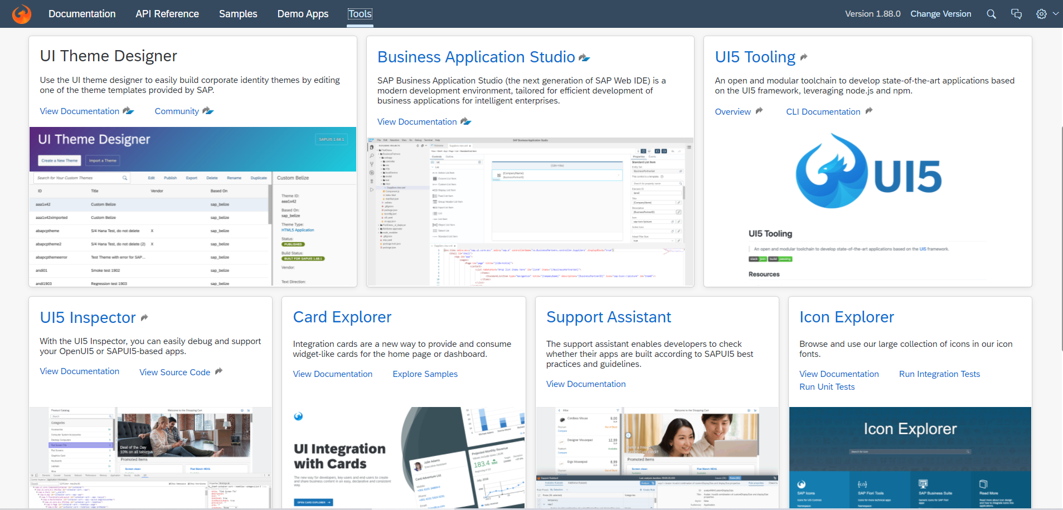
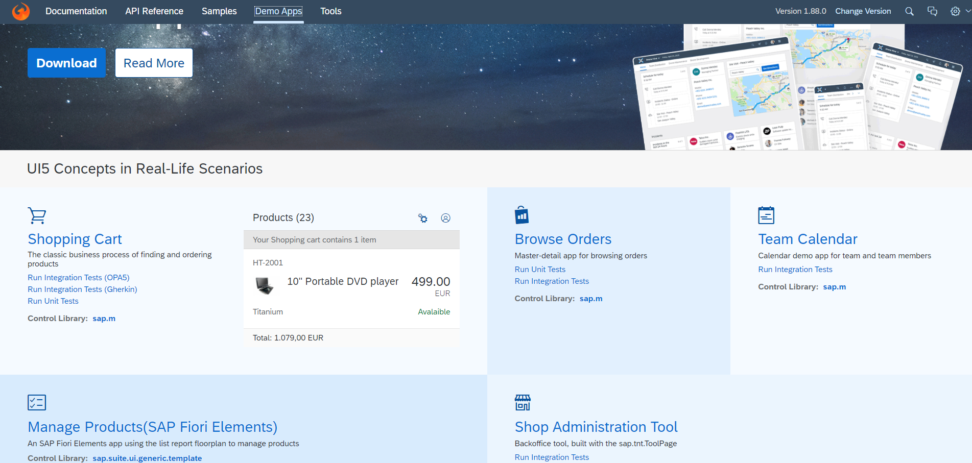
UI5 SDK continues…
UI5 SDK contains tools to make the development smooth for the developers.
It has UI5 icon packs which can be directly accessed for the UI5 SDK’s Tool Screen (Link).
SAP UI5 SDK provides us the demo application, So we can get an idea about how to create different type of applications using UI5 controls
UI5 SDK Tools Screen
UI5 SDK Demo Apps Screen

Slide 8
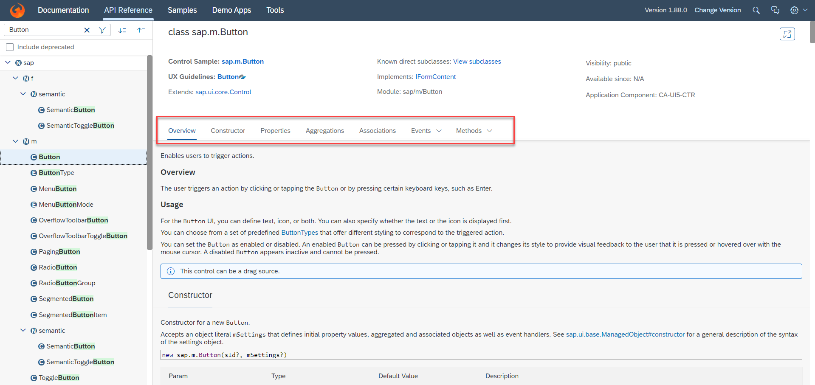
UI5 SDK continues…
When we search and open any API we see a screen similar to one which is shown below.
Every API contains different kind of:
Properties,
Aggregations,
Associations,
Events,
Methods

Slide 9

End of Day 5

Slide 10

Any Questions ?

Slide 11

Anubhav Oberoy

Slide 12
Title
Content

Slide 13
Title
Content

Slide 14
Title
Content

